Slide 1
Architecting a Highly Available SAP NetWeaver Solution on Azure
Notes:
Welcome to the real-world Whiteboard Design Case Study dedicated to architecting a highly available SAP NetWeaver solution on Azure

Slide 2
Abstract and learning objectives
Abstract
Deploy and configure SAP on Azure infrastructure and SAP NetWeaver deployment running on Azure infrastructure, including SAP NetWeaver ASCS and SAP NetWeaver database servers. Key takeaways are the Azure infrastructure solution components and the way they are put together to run SAP applications as well as the Solution architecture references.
Learning objectives
Attendees will be better able to deploy SAP on Azure infrastructure components as well as the following tasks:
Perform a SAP on Azure need assessment
Take part in SAP on Azure Architecture Design Discussion
Respond to RFI/RFP for SAP on Cloud opportunity
Notes:
Abstract and learning objectives

Slide 3
Step 1: Review the customer case study
Outcome
Analyze your customer needs
Timeframe
30 minutes
Notes:
We’ll start by reviewing the customer case study. The intended outcome is to analyze the customer’s needs. The expected timeframe is 30 minutes.

Slide 4
Customer situation—Contoso Group
US-based telecommunications company with headquarters in NY
Looking to optimize its IT environment
Considering moving some of its on-premises SAP workloads to Azure
Goal is to improve agility without compromising availability and performance
Notes:
Contoso Group is a US-based telecommunications company with headquarters in New York
Looking to optimize its IT environment
Considering moving some of its on-premises SAP workloads to Azure
Goal is to improve agility without compromising availability and performance

Slide 5
Customer situation (continued)
Contoso Group maintains an on-premises deployments of SAP Business Suite on Windows Server 2012 R2 with a SQL Server 2014 Database in its US-based data center
IT challenges include:
Keeping up with the pace of business because of the time it takes to move through development and testing phases and implement new business processes into production
Scaling production workloads to meet business needs
Provisioning a test environment that matches production
Providing high availability and disaster recovery capabilities for production workloads
Notes:
Contoso Group maintains an on-premises deployments of SAP Business Suite on Windows Server 2012 R2 with a SQL Server 2014 Database in its US-based data center
IT challenges include:
Keeping up with the pace of business because of the time it takes to move through development and testing phases and implement new business processes into production
Scaling production workloads to meet business needs
Provisioning a test environment that matches production
Providing high availability and disaster recovery capabilities for production workloads

Slide 6
Customer situation (continued)
Complains that agility of the organization is hampered by time to acquire and provision project-related SAP development and testing environments
Would like to lower TCO for the SAP landscape, including the production ECC
Concerned about managing test/dev infrastructure costs
Concerned about aging data center and hardware
Notes:
The customer complains that agility of the organization is hampered by time to acquire and provision project-related SAP development and testing environments
It is concerned about managing test/dev infrastructure costs, about aging data center and hardware and would like to lower TCO for the SAP landscape, including the production ECC

Slide 7
Customer situation (continued)
“Our existing on-premises SAP development and test environments no longer meet the agility required by the fast pace of changes in our business. In addition, our operational dependencies on SAP applications force us to seek reasonably priced availability and disaster recovery capabilities for our production SAP deployments.”
Andrew Cross, CIO, Contoso Group
Notes:
The CIO, Andrew Cross stated “Our existing on-premises SAP development and test environments no longer meet the agility required by the fast pace of changes in our business. In addition, our operational dependencies on SAP applications force us to seek reasonably priced availability and disaster recovery capabilities for our production SAP deployments.”

Slide 8
Customer needs
Reduce time to deploy new business processes to have competitive customer offers
Reduce time required to provision development and test environments
Lower costs incurred by the development, test, and production environments
Identify the monthly infrastructure cost for operating the new solution
Notes:
Customer needs include:
Reducing time to deploy new business processes to deliver competitive customer offers
Reducing time required to provision development and test environments
Lowering costs incurred by the development, test, and production environments
Identifying the monthly infrastructure cost for operating the new solution

Slide 9
Customer objections
If I have already paid for my hardware to host my dev/test environment, how am I getting any cost savings by moving it to Azure? How much more is your cloud solution costing me?
What if I need my cloud resources to access on-premises resources?
Will Azure meet our security and compliance requirements?
Do I have to pay for resources when they are stopped?
For my dev environment, can I automate stopping VMs during idle times?
Notes:
Customer raised some concerns and objections:
If I have already paid for my hardware to host my dev/test environment, how am I getting any cost savings by moving it to Azure? How much more is your cloud solution costing me?
What if I need my cloud resources to access on-premises resources?
Will Azure meet our security and compliance requirements?
Do I have to pay for resources when they are stopped?
For my dev environment, can I automate stopping VMs during idle times?

Slide 10






Customer environment
SAP : SAP ERP/ECC 6.0
OS : Windows Server 2012 R2
DB : SQL Server 2014
Production APP server : 8 cores, 32GB RAM x 3 nodes
Application tier SAPS : 30,000 SAPS
Production DB server : 8 cores, 32GB RAM x 1 node
Database tier SAPS : 15,000 SAPS
IOPS (Production DB data files) : 10,000 IOPS
Production DB size : 750GB with max growth to 1TB
SLA : RPO=15min, RTO = 6hr, HA/DR is required
DB : t-log backup every 15 min, daily full backup retained for 1 month, monthly full backup for 1 year
Other solutions required: Backup, Monitoring, Security
`
Test/Dev
Application
Database
Production
SAN Storage
Tape devices
Azure Migration
Dev/Test, DR and Production on Azure
Compute/storage sizing ?
High Availability and DR ?
Cloud migration ?
End users
Legacy systems
Notes:
To summarize, the technical requirements include the following:
SAP ECC NetWeaver (app server) is the application tier
SQL Server 2014 is the data tier
Application tier requires 30,000 SAPS
Database tier needs 15,000 SAPS
SLA: RPO=15 min, RTO=6 hour

Slide 11
Contoso Current SAP State/Benefits of Migration to Azure
Current State
???
???
???
1
2
3
********
1
2
3
???
???
???
********
Benefits of Microsoft Cloud Platform
Notes:
Consider the current state of Contoso’s SAP environment and benefits of migrating it to Azure.

Slide 12
How to Size SAP on Azure VM
1
Choose VM type for SAP ASCS , Application and Database, based on SAPS required
2
Decide Premium Storage type and # of disks for SAP database file space, based on IOPS/throughput
3
Set up high availability solution for SAP ASCS and Database, based on SLA
Customer Requirements
Sizing for Azure
 | SAPS needed | IOPS needed | Current DB Volume | Azure VM Type | # of VMs | All Active ? | SAPS provided | Database Files Premium Storage SKU and number of disks | IOPS for Database Files provided | Storage size allocated for DB files | Database Log Premium Storage SKU and number of disks | Latency for Log
SOFS | - | - | - | E2_v3 | 2 | Active/ Passive | -
ASCS (*) | 30,000 | - |  | ?? | ?? | Active/ Passive | ?? | -
Application |  | - |  | ?? | ?? | All Active | ?? | -
Database | 15,000 | 10,000 | 1TB | ?? | ?? | Active/ Passive | ?? | ?? | ?? | ?? | ?? | Single digit ms latency
3
2
2
1
3
1
Notes:
In your sizing exercise, use the table presented on the current slide, and note the sequence of steps you should follow when sizing individual tiers of your solution.

Slide 13
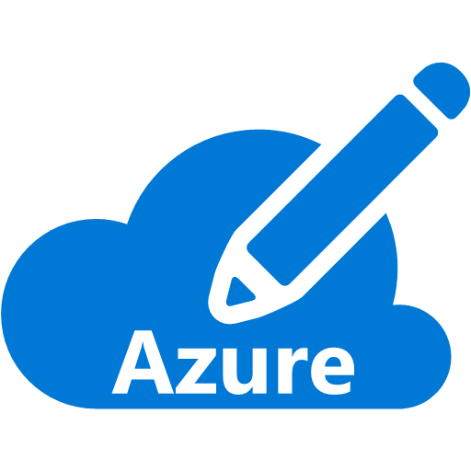
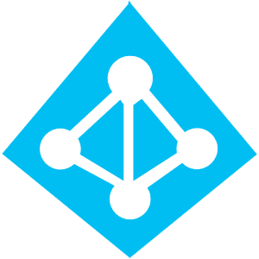





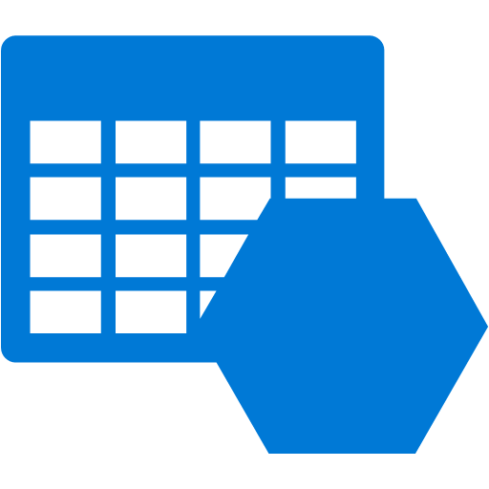
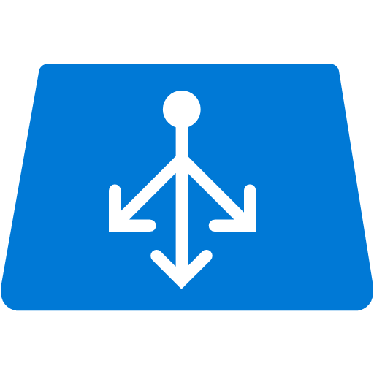
Baseline Knowledge for SAP as a Service on Azure
Icon | Name | Description
 | Region | An area within a geo that does not cross national borders and contains one or more datacenters.
 | Subscription | A customer's agreement with Microsoft that enables them to obtain Azure services.
 | Azure Active Directory (Tenant) | Azure Active Directory helps you manage user identities and create intelligence-driven access policies to secure your resources.
 | ExpressRoute | Direct Connectivity from customer network to Microsoft Enterprise Edge (MSEE)
 | MSEE (Enterprise Edge) | Each ExpressRoute circuit consists of two connections to two Microsoft Enterprise edge routers (MSEEs) from the connectivity provider/your network edge.
 | Virtual Network | A network that provides connectivity between your Azure resources that is isolated from all other Azure tenants.
 | Subnet | A subnetwork or subnet is a logical subdivision of an IP network.
 | Network Security Group | NSG contains a list of security rules that allow or deny network traffic to resources connected to Azure Virtual Networks (VNet)
 | VPN Gateway | A specific type of virtual network gateway that is used to send encrypted traffic between an Azure virtual network and an on-premises location over internet.
 | ExpressRoute Gateway | A specific type of virtual network gateway that is used to send traffic between an Azure virtual network and an on-premises location over ExpressRoute/Direct Peering.
 | Virtual Machines | The software implementation of a physical computer that runs an operating system.
 | Azure Premium Storage and Managed Disks | Azure Storage offers a massively scalable object store for data objects, a file system service for the cloud
 | Availability Set | A collection of virtual machines that are managed together to provide application redundancy and reliability.
 | Internal Load Balancer | ILB directs traffic only to resources that are inside a virtual network or that use a VPN to access Azure infrastructure. (Layer 4)
 | HANA on Azure Large Instances | HANA tailored data center integration (TDI) certified server hardware infrastructure
 | NFS Storage | HANA tailored data center integration (TDI) certified storage infrastructure
 | High Availability Pair | two or more identical HANA large instances deployed in the same region and configured by the customer for system replication
 | Backend ExpressRoute | Backend network to connect Azure Virtual Network and HANA Large Instances stamp
 | Azure Backbone Network | Microsoft owned global fiber network linking all Azure datacenters
 | Regional Pairs | Regional protection within data residency boundaries
MSEE

Slide 14

SAP Business Suite, NetWeaver – with HA and DR
How to design highly available ASCS, SOFS and AP ?
How to design highly available SQL Server VMs ?
What other Azure services can be used ?
Azure Datacenter East US 2
VPN/ ExpressRoute Gateway SKU ?
Azure Virtual Network #1
GW Subnet
Subnet #1 – AP Prod
Subnet #2 – DB Prod
MSEE
ExpressRoute
Domain controller and other VMs ?
Azure Datacenter West US 2
Azure Virtual Network #2
GW Subnet
Subnet #4 – AP DR
Subnet #5 – DB DR
Subnet #6 Mgmt
What are DR solutions ?
HANA Database Server(s) Prod
ExpressRoute or/and S2S VPN ?
MSEE
Notes:
Your HA/DR design should eliminate all SPOFs and include cross-Azure region resiliency.

Slide 15
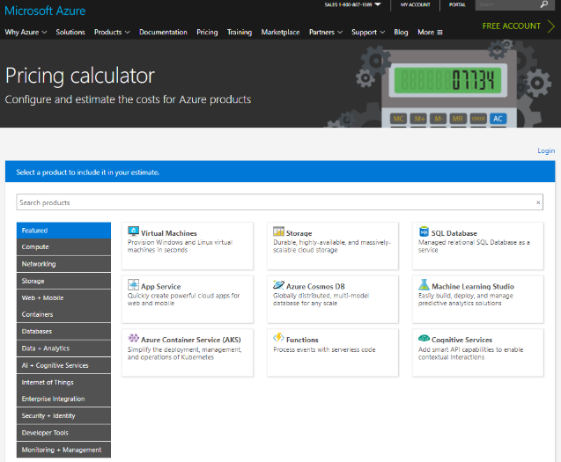
Online Azure Pricing Calculator
https://azure.microsoft.com/en-us/pricing/calculator/
Notes:
To estimate the cost of your solution, use Azure Pricing Calculator.

Slide 16
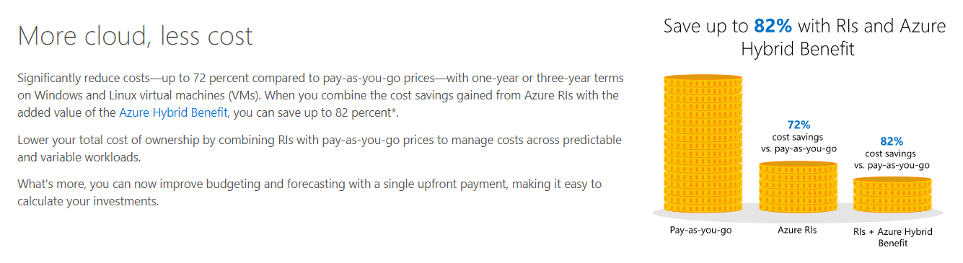
Azure Reserved VM Instances (RI) and Azure Hybrid Benefit (AHUB)
https://azure.microsoft.com/en-us/pricing/reserved-vm-instances/
https://azure.microsoft.com/en-us/pricing/hybrid-benefit/
Notes:
Take into account the reduced pricing offered by AHUB and reserved instances.

Slide 17
Requirements
 | Requirement | (Y/N)
1 | Problem statement and customer benefits
2 | Secure and low latency network connectivity
3 | Windows-based application tier
4 | SQL Server-based database tier
5 | Specific sizing (SAPS) requirements (application tier)
6 | Specific sizing (SAPS) requirements (database tier)
7 | Specific IO requirements
8 | HA capabilities (3 tier deployment)
9 | Load-balanced front-end for (A)SCS
10 | Load-balanced front-end for the database tier
11 | Backup solution and storage for data retention
12 | Monitoring solutions
13 | Security solutions
14 | DR capabilities (multi-region deployment)
15 | Monthly cost estimate
16 | Migration methodology
Notes:
To produce the design, use the following sequence of steps.

Slide 18


Common Scenarios
Availability Set (99.95%)
Single Instance SLA (99.9%)
Fault Domain
Fault Domain
Rack
Rack
Virtual Machine
Virtual Machine
Availability Set
UD #2
Azure Premium Storage Account
UD #1
Notes:
To produce the design, use the following sequence of steps.

Slide 19


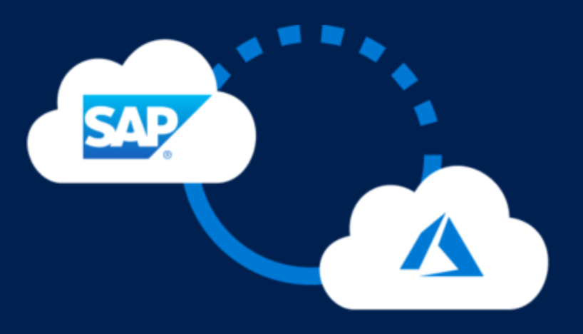
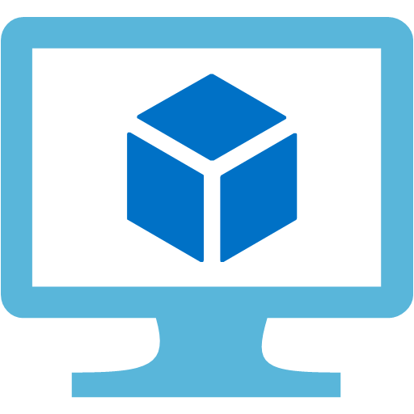

Common Scenarios
Azure Infrastructure as a Service (IaaS)
SAP on Azure
Virtual machines
Virtual networks
VPN gateway
Hybrid connectivity
Load balancers
Storage
https://aka.ms/sapazure
Notes:
To produce the design, use the following sequence of steps.

Slide 20
Step 2: Design the solution
Outcome
Design a solution and prepare to present the solution to the target customer audience in a 15-minute chalk-talk format.
Timeframe
60 minutes
Business needs (10 minutes) | Respond to questions outlined in your guide and list the answers on a flipchart.
Design (35 minutes) | Design a solution for as many of the stated requirements as time allows. Show the solution on a flipchart.
Prepare (15 minutes) | Identify any customer needs that are not addressed with the proposed solution. Identify the benefits of your solution. Determine how you will respond to the customer’s objections. Prepare for a 10-minute presentation to the customer.
Notes:
Now it’s time to design the solution and prepare to present it to the target customer audience in a 15-minute chalk-talk format. The expected timeframe is 60 minutes.

Slide 21
Step 3: Present the solution
Outcome
Present a solution to the target customer in a 15-minute chalk-talk format
Timeframe
30 minutes (15 minutes for each team to present and receive feedback)
Directions
Pair with another table
One table is the Microsoft team and the other table is the customer
The Microsoft team presents their proposed solution to the customer
The customer asks one of the objections from the list of objections in the case study
The Microsoft team responds to the objection
The customer team gives feedback to the Microsoft team
Tables switch roles and repeat Steps 2 through 6
Notes:
Now it’s time to present the solution to the target customer audience in a 15-minute chalk-talk format. The expected timeframe is 30 minutes.
To present the solution, use the following sequence of steps:
Pair with another table.
One table is the Microsoft team and the other table is the customer.
The Microsoft team presents its proposed solution to the customer.
The customer asks one of the objections from the list of objections.
The Microsoft team responds to the objection.
The customer team gives feedback to the Microsoft team.
Tables switch roles and repeat Steps 2 through 6.

Slide 22
Wrap-up
Outcome
Identify the preferred solution for the case study
Identify solutions designed by other teams
Timeframe
30 minutes
Notes:
To wrap-up the case study, identify the preferred solution for the case study and compare it with solutions designed by other teams. The expected timeframe for completing this step is 30 minutes.

Slide 23
Preferred target audience
Business Development Manager (BDM) or Application Sponsor (CFO)
Funds projects & apps
Most interested in public cloud
Business Unit IT / Developers (Director of SAP Business Analysts, Director of SAP Operations)
Reports to BDM and is responsible for coding and testing apps
Big influencer of public cloud strategy
Central IT (VP of IT Operations)
Reports into CIO and responsible for operating datacenter
Concerned about shadow IT created issues: security/compliance, server sprawl, and lack of control
Notes:
The target audience should consist of:
Business Development Manager (BDM) or Application Sponsor (CFO)
Funds projects & apps
Most interested in public cloud
Business Unit IT / Developers (Director of SAP Business Analysts, Director of SAP Operations)
Reports to BDM and is responsible for coding and testing apps
Big influencer of public cloud strategy
Central IT (VP of IT Operations)
Reports into CIO and responsible for operating datacenter
Concerned about shadow IT created issues: security/compliance, server sprawl, and lack of control

Slide 24
Contoso Current SAP State/Benefits of Migration to Azure
Current State
Contoso SAP is ERP/ECC on SQL Server
Fixed size of hardware - underutilized /oversized
Largest server 8-core, 32GB RAM, 1TB DB
No virtualization identified
No BI/Analytics solution identified
Concerned about migration ?
1
2
3
4
5
6
1
2
3
4
5
6
Contoso SAP are fully certified for Azure – and OS/DB upgradable
Contoso SAP can scale any time in Azure
8-core Azure VM is $0.5/hour – largest VM is 128-core, 4TB RAM, 134k SAPS
Full virtualization, automation and standardization
Power BI & a variety of BI/Analytics solutions available in Azure
SAP system copy tool can be used for cloud migration
Benefits of Microsoft Cloud Platform
Notes:
Review the current state of the Contoso’s SAP environments and compare it with the benefits offered by Azure.

Slide 25
How to Size SAP on Azure VM
1
Choose VM type for SAP ASCS , Application and Database, based on SAPS required
2
Decide Premium Storage type and # of disks for SAP database file space, based on IOPS/throughput
3
Set up high availability solution for SAP ASCS and Database, based on SLA
Customer Requirements
Sizing for Azure
 | SAPS needed | IOPS needed | Current DB Volume | Azure VM Type | # of VMs | All Active ? | SAPS provided | Database Files Premium Storage SKU and number of disks | IOPS for Database Files provided | Storage size allocated for DB files | Database Log Premium Storage SKU and number of disks | Latency for Log
SOFS | - | - | - | E2s_v3 | 2 | Active/ Passive | -
ASCS (*) | 30,000 | - |  | E2s_v3 | 2 | Active/ Passive | 2,178 | -
Application |  | - |  | E16s_v3 | 2 | All Active | 34,840 | -
Database | 15,000 | 10,000 | 1TB | E16s_v3 | 2 | Active/ Passive | 17,420 | 2 x P30 disks (1TB, 5000 IOPS/ disk) | 10,000 | 2TB | 1 x P20 disk (0.5TB, 2500 IOPS /disk) | Single digit ms latency
3
2
2
1
3
1
Notes:
Given the existing Contoso environment, here is the proposed sizing of our proposed implementation in Azure.

Slide 26





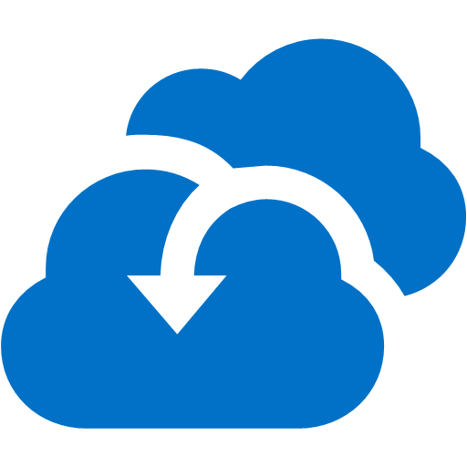

SAP Business Suite, NetWeaver – with HA and DR
3
6
4
Highly available SAP ASCS and SOFS Clusters – VM uptime SLA : 99.95%
2-node x SQL Server AlwaysOn sync replica Uptime SLA : 99.95%
Log Analytics, Backup
Azure Datacenter East US 2
ER Gateway Standard (1Gbps) or High (2Gbps)
2
Azure Virtual Network #1
GW Subnet
Subnet #1 – AP Prod
Subnet #2 – DB Prod
Subnet #3 Mgmt
Storage
Auto mation
Availability Set SAP ASCS
Availability Set
HANA Database Server(s) Prod
Availability Set SAP AP
MSEE
Backup
Log Analytics
Availability Set Scale Out File Server
Express Route Gateway
Site Recovery
Security Center
ExpressRoute
Domain controller, Azure Backup Server (SCDPM)
5
Azure Datacenter West US 2
Azure Virtual Network #2
GW Subnet
Subnet #4 – AP DR
Subnet #5 – DB DR
Subnet #6 Mgmt
Storage
Auto mation
Availability Set SAP ASCS
SQL Server AlwaysOn async replica use smaller VM
HANA Database Server(s) Prod
Availability Set SAP AP
MSEE
Backup
Log Analytics
One ExpressRoute contract can connect to all datacenters in a geopolitical region (e.g. All US DCs)
Availability Set Scale Out File Server
Express Route Gateway
7
1
Shutdown VMs when unused – ASR can NOT be used for ASCS
Site Recovery
Security Center
8
Notes:
Here is a diagram illustrating the complete solution, including the Disaster Recovery environment, with US East 2 as the primary region and US West 2 as the secondary
The primary Azure region will host highly available ASCS components, leveraging Windows Failover clustering. Access to ASCS components will be provided via an Azure Internal Load Balancer. The database tier will consist of two highly available SQL Server instances implemented by using SQL Server AlwaysOn and exposed to the application tier via an Internal Load Balancer. We will also rely on SQL Server AlwaysOn to accommodate the disaster recovery requirement by replicating asynchronously content of the AlwaysOn Availability group to the other Azure region. To accomplish high availability on the application tier, we will deploy two Azure VMs hosting the Primary application server an additional application server.
The second Azure region will host the third node of the SQL Server AlwaysOn cluster that, during normal business operations, can serve quality assurance, development, and test purposes. Note that, in an event of a disaster, we would need to provision the ASCS and SAP application servers in this region. This can be accomplished by using the backup and restore approach.

Slide 27
Cost Estimate Assumptions
Included
Frontend ExpressRoute (customer – Azure VM) 500Mbps – Microsoft cost
3TB outbound (Azure VM -> outside)
SAP ASCS server VMs x 2 nodes x 2 (HA/DR)
E2s_v3, 2-core, 16GB of RAM, 2.1k SAPS / VM
Uptime SLA : 99.95%
SOFS VMs x 2 nodes x 2 (HA/DR)
E2s_v3, 2-core, 16GB of RAM
Uptime SLA : 99.95%
SAP application server VMs x 2 nodes x 2 (HA/DR)
16-core, 128GB of RAM, 17k SAPS / VM
SAP database server VMs x 3 nodes
16-core, 128GB of RAM, 17k SAPS / VM
4TB SSD Storage / VM
Uptime SLA : 99.95%, AlwaysOn sync/async
3-year reserved instance discount
Standard-performance ExpressRoute Gateway x 2
Azure Backup Server VM x 2 with 5TB Storage
5-day data/log backup retention (short term)
Read Access Zone Redundant (RAGRS) Cool Storage : 35TB
750GB x (31 days + 12 months)
NOT Included
Frontend ExpressRoute (customer – Azure VM) 500Mbps – MPLS provider cost
Software licenses of SAP, SQL Server and Windows Server (use AHUB for Windows)
Microsoft Premier Support
Migration SI, Managed Services
Notes:
Some of the cost of the proposed solution is not included in the pricing estimate, primarily those resulting from the network connectivity infrastructure, licensing, and support requirements.

Slide 28
Preferred solution cost
Notes:
The estimated cost of the solution (as of 03/25/18) is $6,347.71 per month.

Slide 29
Preferred solution cost
Notes:
Demonstrate the usage of the cost calculator worksheet by double-clicking on the Microsoft Excel Worksheet on the current slide.

Slide 30
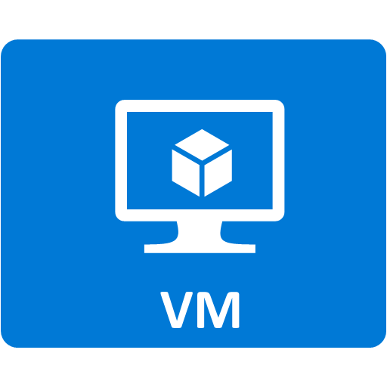
Azure VM Design Tips
Use certified VM types
Use Premium Storage for database
Make sure to have additional storage for backup
Set up HA + DR as needed
Guide customer to use ExpressRoute
1
2
3
4
5
Notes:
The proposed design:
Uses SAP certified VM sizes (required)
Uses Premium Storage for databases (required)
Accounts additional storage for backup (as per customer’s specifications)
HA/DR (as per customer’s specifications)
Uses ExpressRoute (as per customer’s specifications)

Slide 31
Process to Optimize SAP Landscape
Size
Build
Adjust
Monitor
Re-size
Notes:
The solution sizing is a continuous process that involve monitoring, re-sizing, and adjusting. Fortunately, resizing Azure VMs is a straightforward process.

Slide 32
SAP on Azure Certifications (Any DB)
Category | Scenario | SAP Product | Guest OS | Database | VM/Server Type
SAP Any DB | - | SAP Business Suite 6.x (SAP NetWeaver Application Server 7.x) | Windows, SUSE, Red Hat, Oracle Linux *1 | SQL Server, ASE, Oracle, MaxDB, DB2/UDB | D/DS11_v2 – D/DS15_v2 GS1 – GS5 D_v3, E_v3, M
 |  | SAP Business All-in-One
 |  | SAP NetWeaver Application Server 7.x (ABAP and Java)
 |  | SAP BPC NetWeaver
 |  | SAP BPC Microsoft 10.01 | Windows | SQL Server
 |  | TREX 7.10 | Windows, SUSE, Red Hat *1 | N/A
 |  | SAP LiveCache, SAP Content Server 6.50 | Windows, SUSE, Red Hat *1 | MaxDB
 |  | SAP BusinessObjects BI/Dashboards/WebIntelligence/Explorer 4.1, Crystal Reports 2013 4.1, Design Studio BI Platform, Data Services 4.2 | Windows Server | N/A
 |  | SAP Business One | Windows Server | SQL Server
(*1) SUSE and Red Hat are certified only with ASE, DB2 and HANA. Oracle Linux is for Oracle. Windows Server is for all databases.
Notes:
You must ensure that the combination of the server OS and the database management platform is supported by SAP.

Slide 33

Qualifying SAP on Azure Opportunities (Any DB)
Start
Dev/Test
Or Production ?
OS= Windows, DB = SQL, Oracle, ASE, MaxDB or DB2 ?
OS = Linux, DB = ASE or DB2 ?
OS = UNIX, DB = ASE or DB2 ?
OS = UNIX, Linux, DB = Oracle ?
Prod
No
No
No
Dev/ Test
Yes
Yes
Yes
Yes
Propose migration of all non-production SAP systems to Azure. SAP certification is not required.
Propose migration of all SAP systems to Azure. Propose SQL Server migration as well.
Propose migration of all SAP systems to Azure. Get DB vendor’s support if HA is required. Propose SQL Server migration as well.
Propose migration of all SAP systems to Azure. Target OS is Windows or Linux (SLES or RHEL). Get DB vendor support if HA is required Propose SQL Server migration as well.
Propose migration of all SAP systems to Azure. Target OS is Windows or Linux (Oracle Linux).
Don’t propose SLES or RHEL. Propose SQL Server migration as well.
Notes:
When choosing the OS/DBMS platform, follow the workflow provided on this slide.

Slide 34







Modernizing SAP Platform on Microsoft Cloud OS
SAP on Windows/SQL Server on Azure VM
SAP on Windows/SQL
SAP on Linux/DB2 on Azure VM
SAP on Linux/DB2
EXPORT
IMPORT
SAP on UNIX/Oracle
OS/DB independent dump files
SAP on Windows/Oracle on Azure VM
SAP on Mainframe/DB2
SAP on Linux/HANA on Azure VM + HANA Large Instances
Notes:
As part of the migration, you have the option of modernizing your SAP platform.

Slide 35
Azure VM Options for SAP Applications
Red : certification in roadmap
VM Series | VM Type | VM Size | Temp SSD | SAPS | # of v-disks | Max IOPS (cached) | Max Disk Bandwidth (cached) | Max Network Bandwidth | Compute (No OS) hourly on demand, USE2 | Supported HANA scenarios | Remark | SAP certification
DS v2 | DS11_v2 | 2 vCPU, 14 GiB | 28 GiB | 3,530 | 4 | 8,000 | 64 MB/sec | High | $ 0.149 |  | Intel Xeon E5-2673 v3 (Haswell), 2.4 GHz | Certified (Any DB, App)
 | DS12_v2 | 4 vCPU, 28 GiB | 56 GiB | 6,680 | 8 | 16,000 | 128 MB/sec | High | $ 0.229
 | DS13_v2 | 8 vCPU, 56 GiB | 112 GiB | 12,300 | 16 | 32,000 | 256 MB/sec | High | $ 0.598
 | DS14_v2 | 16 vCPU, 112 GiB | 224 GiB | 24,180 | 32 | 64,000 | 512 MB/sec | Very high | $ 1.197
 | DS15_v2 | 20 vCPU, 140 GiB | 280 GiB | 30,430 | 40 | 80,000 | 640 MB/sec | Very high | $ 1.497
GS | GS4 | 16 vCPU, 224 GiB | 448 GiB | 22,680 | 32 | 80,000 | 800 MB/sec | Extremely high | $ 4.400 |  | Intel® Xeon® E5 v3 (Haswell) | Certified (Any DB, App) GS5 certified for OLAP & controlled availability for S4
 | GS5 | 32 vCPU, 448 GiB | 896 GiB | 41,670 | 64 | 160,000 | 1,600 MB/sec | Extremely high | $ 7.820 | OLAP and S4
DS v3 | D2s_v3 | 2 vCPU, 8 GiB | 16 GiB | 2,178 | 4 | 4,000 | 32 MB/sec | moderate | $ 0.110 |  | Xeon E5-2673 v4 (Broadwell) 3.5Ghz TB | Certified (Any DB, App)
 | D4s_v3 | 4 vCPU, 16 GiB | 32 GiB | 4,355 | 8 | 8,000 | 64 MB/sec | moderate | $ 0.220
 | D8s_v3 | 8 vCPU, 32 GiB | 64 GiB | 8,710 | 16 | 16,000 | 128 MB/sec | high | $ 0.440
 | D16s_v3 | 16 vCPU, 64 GiB | 128 GiB | 17,420 | 32 | 32,000 | 256 MB/sec | high | $ 0.880
 | D32s_v3 | 32 vCPU, 128 GiB | 256 GiB | 34,840 | 32 | 64,000 | 512 MB/sec | extremely high | $ 1.760
 | D64s_v3 | 64 vCPU, 256 GiB | 512 GiB | 69,680 | 32 | 128,000 | 1024 MB/sec | extremely high | $ 3.520
ES v3 | E2s_v3 | 2 vCPU, 16 GiB | 32 GiB | 2,178 | 4 | 4,000 | 32 MB/sec | Moderate | $ 0.146 |  | Xeon E5-2673 v4 (Broadwell) 3.5Ghz TB | Certified (Any DB, App)
 | E4s_v3 | 4 vCPU, 32 GiB | 64 GiB | 4,355 | 8 | 8,000 | 64 MB/sec | Moderate | $ 0.293
 | E8s_v3 | 8 vCPU, 64 GiB | 128 GiB | 8,710 | 16 | 16,000 | 128 MB/sec | High | $ 0.585
 | E16s_v3 | 16 vCPU, 128 GiB | 256 GiB | 17,420 | 32 | 32,000 | 256 MB/sec | High | $ 1.170 | OLTP/OLAP | Xeon E5-2673 v4 (Broadwell) 3.5Ghz TB | HANA certification in roadmap App, Any DB certified
 | E32s_v3 | 32 vCPU, 256 GiB | 512 GiB | 34,840 | 32 | 64,000 | 512 MB/sec | Extremely High | $ 2.341 | OLTP/OLAP
 | E64s_v3 | 64 vCPU, 432 GiB | 864 GiB | 70,050 | 32 | 128,000 | 1024 MB/sec | Extremely High | $ 4.412 | OLTP/OLAP
M | M32ts | 32 vCPU, 192 GiB | 1,000 GiB | 33,670 |  |  |  |  | $ 2.707 | OLTP | Intel® Xeon® E7-8890 v3 (Haswell) | HANA, App, Any DB certified
 | M32ls | 32 vCPU, 256 GiB | 1,000 GiB | 33,300 |  |  |  |  | $ 2.873 | OLTP
 | M64ls | 64 vCPU, 512 GiB | 2,000 GiB | 66,600 |  |  |  |  | $ 5.415 | OLTP
 | M64s | 64 vCPU, 1,024 GiB | 2,000 GiB | 67,315 | 32 | 80,000 | 800 MB/sec | Extremely high | $ 6.669 | OLTP/OLAP
 | M64ms | 64 vCPU, 1,792 GiB | 2,000 GiB | 68,930 | 32 | 80,000 | 800 MB/sec | Extremely high | $ 10.337 | OLTP
 | M128s | 128 vCPU, 2,048 GiB | 4,000 GiB | 134,630 | 64 | 160,000 | 1,600 MB/sec | Extremely high | $ 13.338 | OLTP/OLAP
 | M128ms | 128 vCPU, 3,800 GiB | 4,000 GiB | 134,630 | 64 | 160,000 | 1,600 MB/sec | Extremely high | $ 26.688 | OLTP
SAP Note 1928533 and https://docs.microsoft.com/en-us/azure/virtual-machines/windows/sizes-memory
Notes:
Double clicking Azure VMs /- here’s the list of SAPS and memory size / of each Azure VM type. D v2 and G are certified as of today / and E v3 and M Series release and certification / are coming soon / with official numbers of SAPS. Customer should feel very free to use / E v3 and M / for their non-prod even without certification / because it works just fine.
Based on total # of SAPS for Any DB, and memory size and HANA scenario – OLAP or OLTP, you can pick VM type for both database server and application server.
https://docs.microsoft.com/en-us/azure/virtual-machines/windows/sizes-memory
https://azure.microsoft.com/en-us/blog/introducing-the-new-dv3-and-ev3-vm-sizes/

Slide 36
Benefits
Reduce time to deploy new business processes to have competitive customer offers
Reduce time required to provision development and test environments
Manage costs incurred by the development and test environments
Lower production environment cost
Notes:
Customer can take advantage of the benefits provided by hosting SAP environment in Azure, including:
Reducing time to deploy new business processes to have competitive customer offers
Reducing time required to provision development and test environments
Managing costs incurred by the development and test environments
Lowering production environment cost

Slide 37
Preferred solution
Architecting a multi-tier SAP solution
Task: Identifying the target Azure region(s) and the number of tiers
Answer: By deploying Azure VMs in two regions (with US East 2 as the primary region and US West 2 as the secondary) we are able to address the Disaster Recovery needs of the customer. From the availability standpoint, one of the first decisions you will need to make is whether you will implement a two-tier or three-tier architecture. Three-tier architecture consists of the presentation tier, the application tier, and the database tier. In the two-tier architecture, application and database tiers are combined together, running on the same operating system instance.
Three-tier architecture is required to provide high availability
Notes:
Now let’s review each of our objectives in more details.
Our first task was to identify the target Azure region and the number of tiers.
By deploying Azure VMs in two regions (with US East 2 as the primary region and US West 2 as the secondary) we are able to address the Disaster Recovery needs of the customer. From the availability standpoint, one of the first decisions you will need to make is whether you will implement a two-tier or three-tier architecture. Three-tier architecture consists of the presentation tier, the application tier, and the database tier. In the two-tier architecture, application and database tiers are combined together, running on the same operating system instance.
Three-tier architecture is required to provide high availability.

Slide 38
Preferred solution
Architecting network connectivity
Task: Design a hybrid network (at a high-level) that that will allow you to meet all of the customer requirements and support your design for moving the customer to Azure.
Answer: Use ExpressRoute between the corporate headquarters and two Azure regions that will host the SAP deployment. For development or training scenarios, it might be sufficient to use a site-to-site Virtual Private Network. You can use the online Azure Speed Test to determine the latency you should expect when establishing a site-to-site VPN connection. However, Site-to-Site VPN connections are, at best, limited to 1.25 Gbps and introduce double digit millisecond latencies. For production SAP workloads hosted in Azure, you should consider using ExpressRoute. This allows for establishing a private connection to Azure, providing up to 10 Gbps of bandwidth and lowering latency to a couple of milliseconds.
Notes:
Our second task was to design a hybrid network (at a high-level) that that will allow you to meet all of the customer requirements and support your design for moving the customer to Azure
We accomplish this by using ExpressRoute between the corporate headquarters and two Azure regions that will host the SAP deployment. For development or training scenarios, it might be sufficient to use a site-to-site Virtual Private Network. You can use the online Azure Speed Test to determine the latency you should expect when establishing a site-to-site VPN connection. However, Site-to-Site VPN connections are, at best, limited to 1.25Gbps and introduce double digit millisecond latencies. For production SAP workloads hosted in Azure, you should consider using ExpressRoute. This allows for establishing a private connection to Azure, providing up to 10 Gbps of bandwidth and lowering latency to a couple of milliseconds.

Slide 39
Preferred solution
Architecting (A)SCS components
Task: Design a scalable geo-redundant solution.
Answer: By deploying Azure VMs in two regions we are able to meet the needs of the customer. Scaling of the (A)SCS tier involves increasing or decreasing the size of Azure VMs. The SAP Central Services Instance is protected by leveraging Window Server Failover Cluster. Windows Server 2016 Scale Out File Server (SOFS) and the Storage Spaces Direct (S2D), enable the creation of a cluster on Azure VMs with the shared disk functionality. This ensures high availability of the messaging service and Enqueue Replication Service components. The SAP Central Service uses the Azure internal load balancer to facilitate failover capability.
Notes:
The next task was to design a scalable geo-redundant solution.
By deploying Azure VMs in two regions we are able to meet the needs of the customer. Scaling of the (A)SCS tier involves increasing or decreasing the size of Azure VMs. The SAP Central Services Instance is protected by leveraging Window Server Failover Cluster. Windows Server 2016 Scale Out File Server (SOFS) and Storage Spaces Direct (S2D) enable the creation of a cluster on Azure that provide the shared disk functionality. This ensures high availability of the messaging service and Enqueue Replication Service components. The SAP Central Service uses the Azure internal load balancer to facilitate failover capability.

Slide 40
Preferred solution
Architecting application components
Task: Design a scalable geo-redundant solution.
Answer: Scaling of the application tier can be accomplished by deploying additional application servers (AAS) to supplement the Primary Application Server. The HTTP(S) load balancing is handled by the SAP Web Dispatcher hosted on an Azure VM. The SAP Logon load balancing is handled by the SCS message server.
Notes:
The next task involved designing a scalable geo-redundant solution.
Scaling of the application tier can be accomplished by deploying additional application servers (AAS) to supplement the Primary Application Server. The HTTP(S) load balancing is handled by the SAP Web Dispatcher hosted on an Azure VM. The SAP Logon load balancing is handled by the SCS message server.

Slide 41
Preferred solution
Architecting database components
Task: Design a resilient and scalable SQL Server backend configured to span geographically distributed datacenters
Answer: Scaling of the database tier involves increasing or decreasing the size of Azure VMs. For Microsoft SQL Server, we use AlwaysOn Availability Group (AG) built on top of the Windows Server Failover Clustering and leveraging the Cloud Witness quorum, eliminating the dependency on a shared disk or a file share. Azure internal load balancer represents the listener of the SQL Server AlwaysOn Availability Group containing the SAP database.
Notes:
The last task was to design a resilient and scalable SQL Server backend configured to span geographically distributed datacenters.
Scaling of the database tier involves increasing or decreasing the size of Azure VMs. For Microsoft SQL Server, we use AlwaysOn Availability Group (AG) built on top of the Windows Server Failover Clustering and leveraging the Cloud Witness quorum, eliminating the dependency on a shared disk or a file share. Azure internal load balancer represents the listener of the SQL Server AlwaysOn Availability Group containing the SAP database.

Slide 42
Preferred objections handling
Objection
If I have already paid for my hardware to run my dev/test environment, how am I getting any cost savings by moving it to Azure?
Potential answer
A Global audit, tax and consulting company reduced TCO by 40-75% by hosting SAP systems on Azure and turning off unused resources; A global snack food company reduced TCO by 40-75% by moving 126 legacy SAP systems on Azure; A medical supply company reduced TCO by 50% by moving SAP training environment to Azure.
Use the TCO tool (http://aka.ms/azuretco) to uncover all categories of potential cost savings (e.g., hardware, software, maintenance, admin, power, facility) .
Because of the large scale of Microsoft’s datacenters, we realize ongoing cost efficiencies that we have been passing to customers in the form of price cuts.
For very large customers, highlight other benefits (e.g., agility, focus) of using Azure.
Notes:
Now let’s address the concerns and objections of the customer.
Our customer stated: If I have already paid for my hardware to run my dev/test environment, how am I getting any cost savings by moving it to Azure?
You can address this concern by pointing out that a Global audit, tax and consulting company reduced TCO by 40-75% by hosting SAP systems on Azure and turning off unused resources; A global snack food company reduced TCO by 40-75% by moving 126 legacy SAP systems on Azure; A medical supply company reduced TCO by 50% by moving SAP training environment to Azure.
Contoso can use the TCO tool (http://aka.ms/azuretco) to uncover all categories of potential cost savings (e.g., hardware, software, maintenance, admin, power, facility).
Because of the large scale of Microsoft’s datacenters, it is possible to realize ongoing cost efficiencies that we have been passing to customers in the form of price cuts.

Slide 43
Preferred objections handling
Objection:
What if I need my cloud resources to access on-premises resources?
Potential answer:
Microsoft supports a hybrid solution, with symmetry between on-premises applications and those on the public cloud.
Windows Azure Virtual Network allows them to create a logically isolated section in Azure and securely connect it to their on-premises datacenter;
If customer needs dedicated connectivity, talk to them about ExpressRoute.
Notes:
Our customer was also wondering - What if I need my cloud resources to access on-premises resources?
One potential answer states that Microsoft supports a hybrid solution, with symmetry between on-premises applications and those on the public cloud.
Windows Azure Virtual Network allows for creating a logically isolated section in Azure and securely connect it to their on-premises datacenter;
If customer needs dedicated connectivity, talk to them about ExpressRoute.

Slide 44
Preferred objections handling
Objection:
Will Azure meet our security and compliance requirements?
Potential answer:
Microsoft policy is to be the most transparent about security and compliance policies, procedures, and certifications on the public facing Azure Trust Center.
Dev/Test workload usually has limited security/compliance requirements.
Encourage the customer to visit our Azure data centers.
Notes:
Another concern dealt with security and compliance requirements.
Microsoft policy is to be the most transparent about security and compliance policies, procedures, and certifications on the public facing Azure Trust Center.
Dev/Test workload usually has limited security/compliance requirements.
Encourage the customer to visit one of Azure data centers.

Slide 45
Preferred objections handling
Objection:
Do I have to pay for resources when they are stopped?
Potential answer:
Yes, the VM must be deallocated before the charges cease. If the VM is stopped, it will continue to incur charges.
Deallocating does not mean deleting the VM as it still exists in storage.
You will still incur storage charge even if the VM is deallocated.
Notes:
The customer was also wondering whether they have to pay for resources when they are stopped?
The answer is the VM must be deallocated before the charges cease. If the VM is stopped, it will continue to incur charges.
Deallocating does not mean deleting the VM, as it still exists in storage.
However, the storage charges still apply even if the VM is deallocated.

Slide 46
Preferred objections handling
Objection:
Can I automate the shut down at periodic times of day?
Potential answer:
Yes, this functionality is available directly from the Azure platform, without the need for a custom solution. In addition, the customer can use Azure Automation runbooks or custom Azure PowerShell and Azure CLI scripts to start Azure VMs on as needed basis.
Notes:
The customer also wanted to automate the shut down at periodic times of day?
Inform the customer that this functionality is built directly into the Azure platform. In addition, the customer can use Azure Automation runbooks with custom Azure PowerShell and Azure CLI scripts to start Azure VMs according to an arbitrary schedule.

Slide 47
Customer quote
“Azure has introduced new opportunities in regard to quickly provisioning development and user acceptance testing environments for our various SAP workloads. It also provided high availability and disaster recovery capabilities for our production environment at a very reasonable price.”
Andrew Cross, CIO, Contoso Group
Notes:
In conclusion, quote Andrew Cross again.
“Azure has introduced new opportunities in regard to quickly provisioning development and user acceptance testing environments for our various SAP workloads. It also provided high availability and disaster recovery capabilities for our production environment at a very reasonable price.”

